Slide 1
Week 11
Module 11

Slide 2
Objectives:
Practice proving neutral advice to support client choice
Practice incorporating MI techniques into a full counseling session
Agenda:
Student presentations
Re-Cap: check in from last week
Review change talk square
Discuss how to handle a client myth
Revisit providing advice
Practice proving neutral advice in an E/O/E format
Group activity: putting it all together
1 minute essay

Slide 3
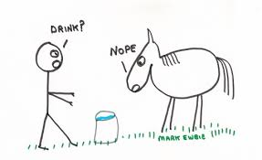
Review:
Who gives change talk?
How should counselors respond to change talk?
How should counselors respond to stay the same talk?
What are the steps to backing off?
Last presentation

Slide 4
Responding to change talk (EARS)
Elaborating: In what way... ?; Tell me more...; What else?
Affirming: That took a lot of courage; You’re a person who can make changes when you need to...
Reflecting: That’s really important to you ...; You realize it’s become a problem...
Summarizing: There are a number of things I’m hearing about your situation. First, you’re concerned about..... Also, you feel..., and you are thinking...

Slide 5
Responding to stay the same talk (DARA)
Double sided reflections: “so on the one hand…but on the other…
Affirming strengths: “this has been super frustrating for you and you’re really determined” “you really care about your child”
Reframe: “you’d like to find activities you have time for.” “your parents really care about you.”
Amplifying: “Cutting back on soda make no sense for you right now.”

Slide 6
Backing Off & Getting Back on Track (review)
State what you see/hear
Acknowledge the resistance
Shift back in your chair & breathe
Offer to let go
Ask/Review client’s goals
Find what the client wants to work on (if anything).

Slide 7

Handling a Myth
Kellogg Video: https://www.youtube.com/embed/uFldGppHFak
What are the questions Kellogg asks as she handles the myth? What is there besides elicit/provide/elicit?.

Slide 8
Practice Handling a Myth
Client: think of a myth (worth addressing).
Counselor’s Steps:
Ask your client to explain more. Use reflection, affirming, and reframing. Build relationship/rapport/shared respect.
Summarize theirs and ask about sharing yours.
Provide facts without urgency.
Elicit their response.

Slide 9
Review Providing Advice
Avoid Queggestions
  What if you got up 15 minutes earlier in the morning?
  Could you prep your lunch at night?
Instead, “I’ve got an idea; would it be okay if I shared it?”
“Some of my other clients find. . .” (better and more effective than “What works for me is…”)

Slide 10
Preface Advice with Choice
You might consider. . .
This might be an option. . .
It’s up to you, I’ll give you some options.
This idea might not fit for you.
I can’t tell you what to do. This is what others have done.
You could try.

Slide 11
Divide into 6 groups
Create a skit showing handling a dangerous myth.

Slide 12
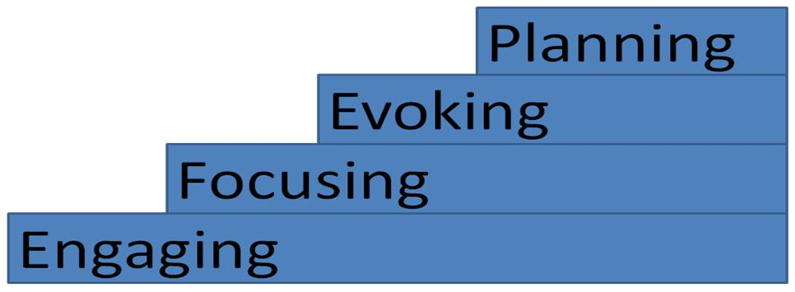
Putting it all together in an outpatient session

Slide 13

Step 1: Engaging:
Confident, warm, introduction…fully present with the client
Unpack using OARS
  Client’s objectives,
  Background
  Current environment
  Get a sense of the main etiology
Elicit or brainstorm ideas with the client about what actions they could take.

Slide 14

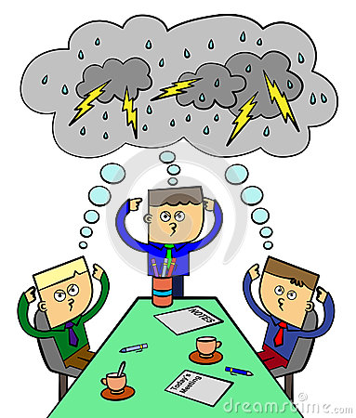
Step 2: Focusing
Using E/P/E, provide information/nutrition education as needed.
Ask the client to decide on steps they’d might like to take
Using E/P/E add your ideas for changes
Elicit change talk and sustain talk/obstacles

Slide 15

Step 3: Evoking
Ask why making these changes is important to them.
Ask client about obstacles they might encounter.
Respond to change talk and sustain talk

Slide 16
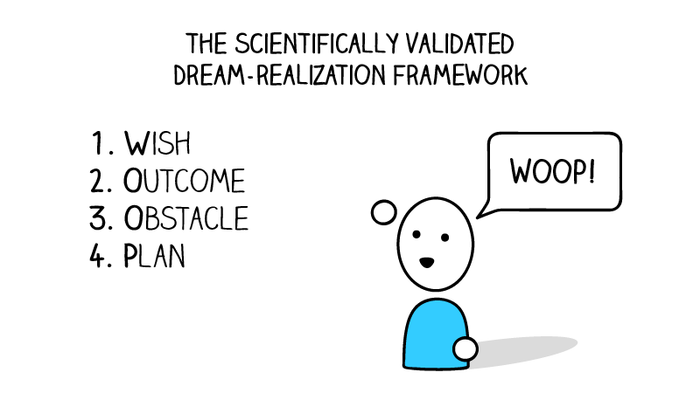
Step 4: Planning
With client, make a specific “if” “then”-type plans
Provide a verbal and print summary of wishes, reasons, obstacles, and plans.
Provide print or online resources.
Arrange the next meeting.
Document client’s plans

Slide 17
Ensure clients have what they need to follow through
Create a personalized, realistic, client-directed plan during the session.
Make sure the plan includes overcoming likely obstacles (self-talk obstacles, environmental obstacles, social obstacles, etc.)
Provide a print and emailed summary of the session including wish, reasons, obstacles, and plans;
Facilitate any needed referrals with a warm or passive hand-off;
Provide additional print, community, and online resources.

Slide 18
Activity:
Provide counseling to our guests.
Using the 4-phases and WOOP framework, help them make a plan.
Use the hand-out to “check” the plan.

Slide 19
Questions about the group presentation or anything else.

